Slide 1
EPOCH ESTIMATION USING DMD
AI IN SPEECH PROCESSING
21AIE315
TEAM 11

Slide 2
Team 11
Arun Prakash J
Asswin C R
Dharshan Kumar K S
Avinash Dora
CB.EN.U4AIE19014
CB.EN.U4AIE19016
CB.EN.U4AIE19024
CB.EN.U4AIE19028

Slide 3
Epoch Detection
01
Related Works
02
TABLE OF CONTENTS
04
Pipeline
DMD
03
05
Inference
Future Work
06

Slide 4
01
Epoch Estimation
Problem Statement

Slide 5
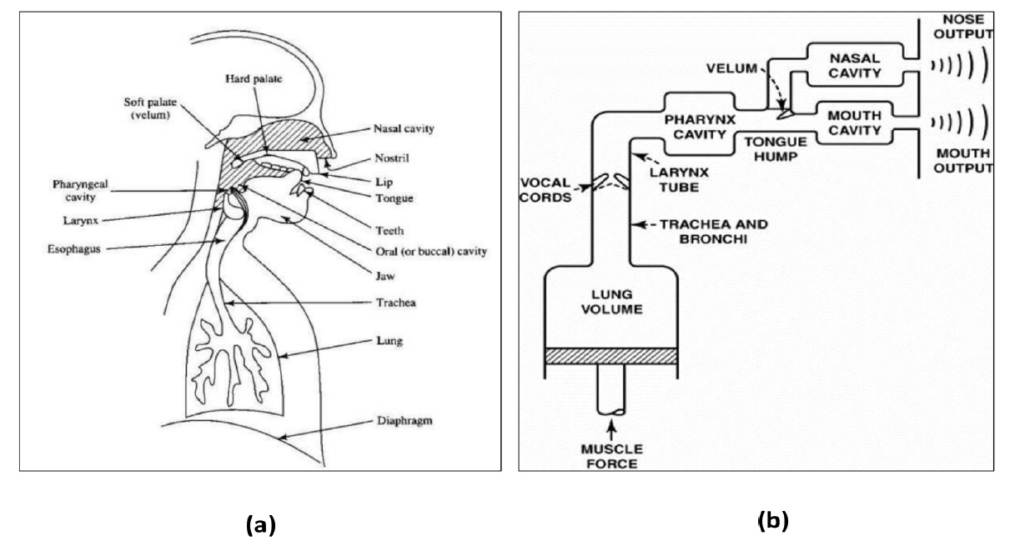
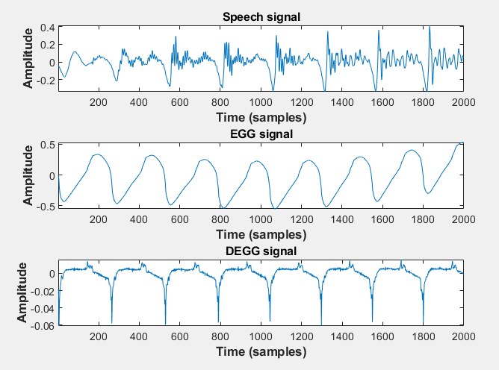
Epoch Production
Human Production System

Slide 6
Speech signal & Epoch locations
Detecting Epoch Locations from Speech signal directly
Instead of EGG signal
GOI
GCI

Slide 7
02
Related Work
Existing Approach

Slide 8
MAJOR WORKS IN EPOCH ESTIMATION
VMD
Source:
Epoch Estimation from Emotional Speech Signals Using Variational Mode Decomposition
[Paper]

Slide 9
MAJOR WORKS IN EPOCH ESTIMATION
VMD
Iterative approach
Mode Mixing occurs when frequency of neighboring modes is near

Slide 10
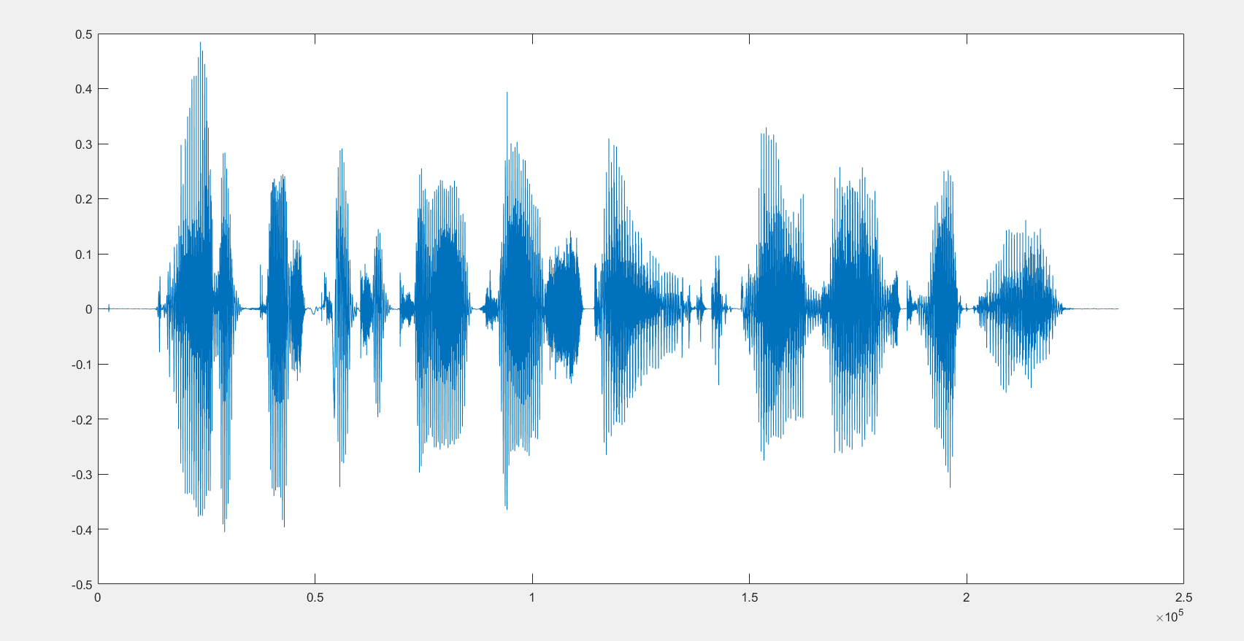
DATASET
CMU Arctic Dataset
Speech & EGG signal
1150 utterances
US English
Male & Female speakers
32 KHz Sampling Frequency

Slide 11
03
DMD
Dynamic Mode Decomposition

Slide 12
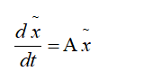
DMD- Basic Theory
Dynamic mode decomposition (DMD) is a dimensionality reduction(transformation of data from a high-dimensional space into a low-dimensional space so that the low-dimensional representation retains some meaningful properties of the original data)
The dynamic mode decomposition is a data processing algorithm that extracts spatial–temporal coherent structures in a given complex system( high dimensional data) and gives a linear model which evolves over a period of time.
It is an equation-free, data-driven method that can capture important dynamical effects even without knowing fully, or partially, the underlying governing equations.
Hypermeter involved – r : no of modes.
A dynamic system is described using a governing set of differential equations.
In DMD procedure, we construct an approximate linear evolution of the system.

Slide 13
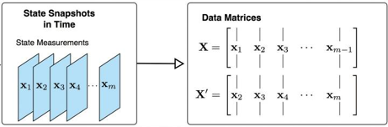
DMD ALGORITHM

Slide 14
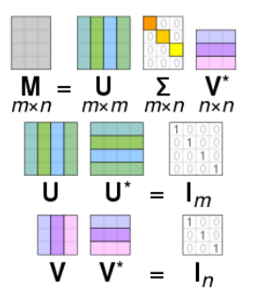
U- dominant coherent structures( contains POD modes.
V- Unitary Matrix
- Diagonal Matrix

Slide 15
DMD Algorithm
Step 1 : Collect the Data.
Step 2 : The data is been organized into 2 matrices , X1 and X2. the columns of X1 are the snapshots of the data reshaped into column vectors which evolve in time. Hence the columns are evolving in time along with the dynamics of the system.
Step 3 : Next X2 is the same data matrix, but advanced one time step in the future(shifted 1 dT ahead).
Step 4 : Now, DMD finds the best fit linear operator A , that maps X2 and X1 and can be expressed as mentioned in eqn(1)
Step 5 : DMD approximates the leading(dominating) eigen values and eigen vectors of the A matrix.
Step 6 : Once we obtain the eigen vectors of the A matrix, it will have the same shape as that of one of the columns of X1 and can be reshaped into a flow field( eigen flow field) – dominant flow field coherent modes.
Step 7 : Thus we obtain the leading eigen decomposition which gives the spatial temporal modes and the time dynamics(eigen values).
Step 8 : Hence by knowing the leading eigen decomposition of A, we can predict how the system will evolve in the future.

Slide 16
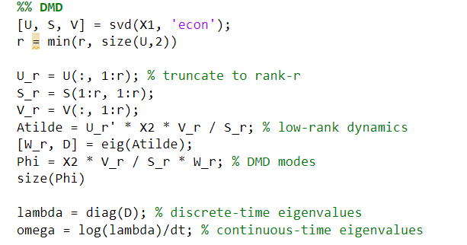
DMD Code

Slide 17
04
PROPOSED PIPELINE
Epoch Estimation

Slide 18
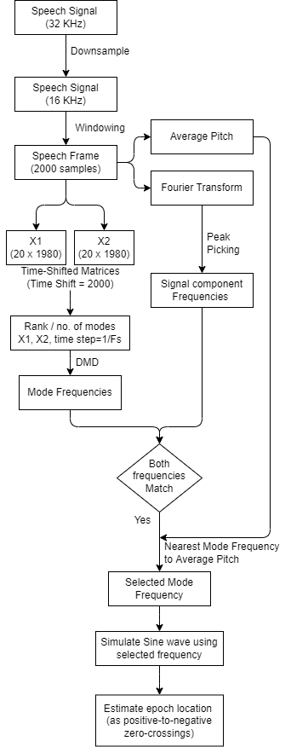
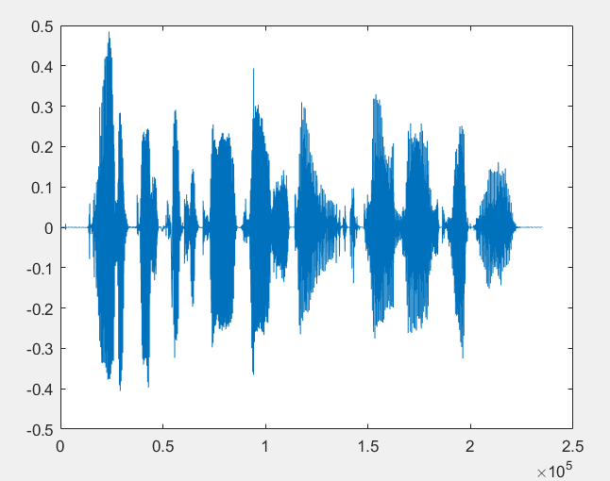
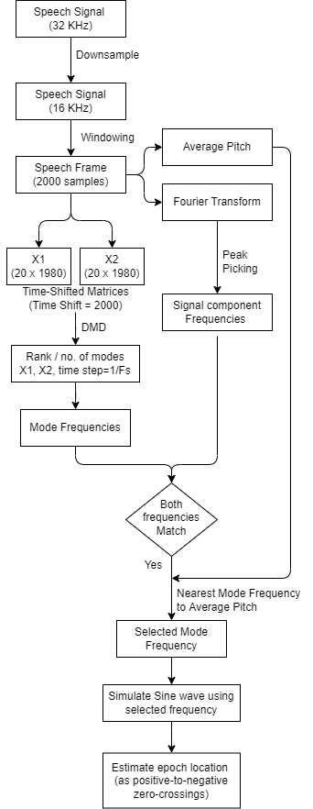
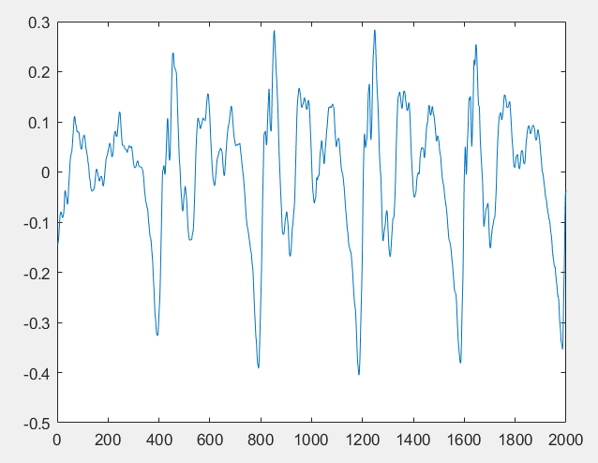
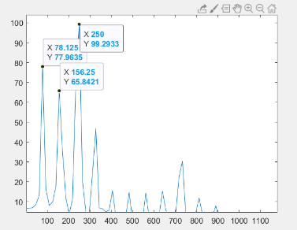
PROPOSED PIPELINE
avg_F0 =
41.2004
needed_freq =
39.0625
70.3125
117.1875

Slide 19
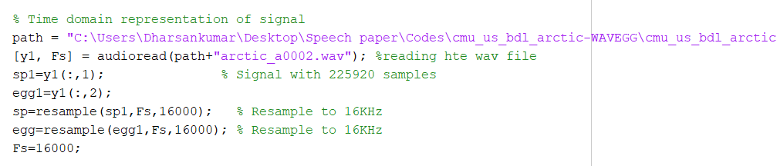
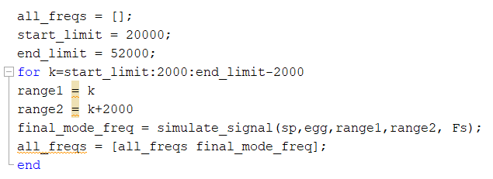
PROPOSED PIPELINE - CODE

Slide 20
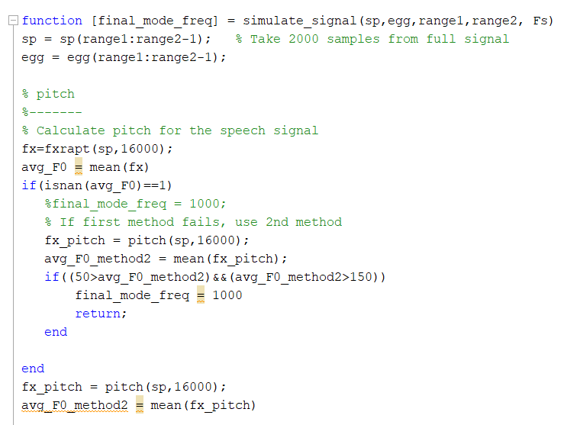
PROPOSED PIPELINE - CODE
avg_F0 =
41.2004

Slide 21
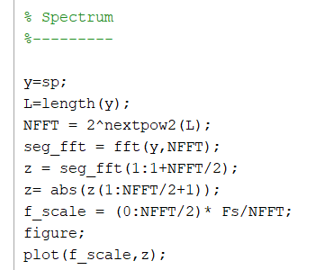
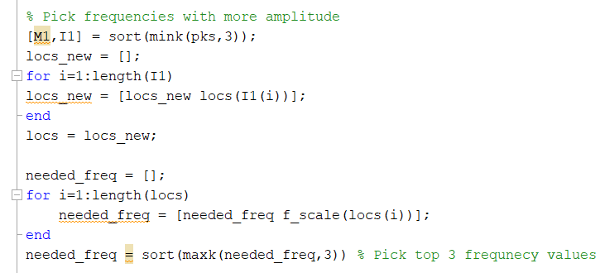
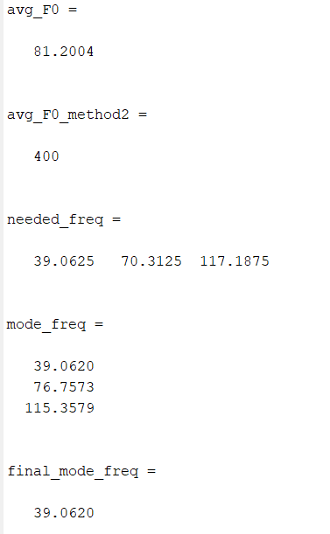
PROPOSED PIPELINE - CODE

Slide 22
PROPOSED PIPELINE
needed_freq =
39.0625
70.3125
117.1875
mode_freq =
39.0620
76.7573
115.3579

Slide 23
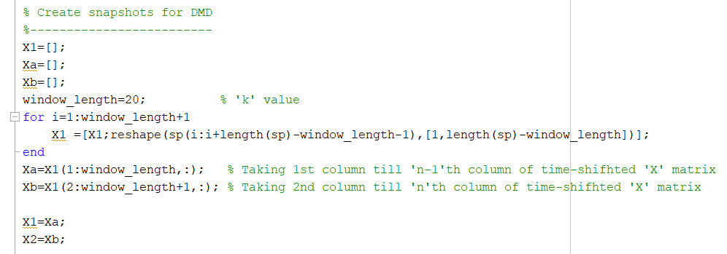
PROPOSED PIPELINE - CODE

Slide 24
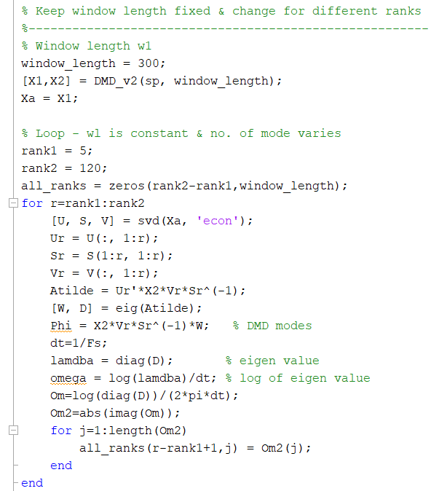
PROPOSED PIPELINE - CODE

Slide 25
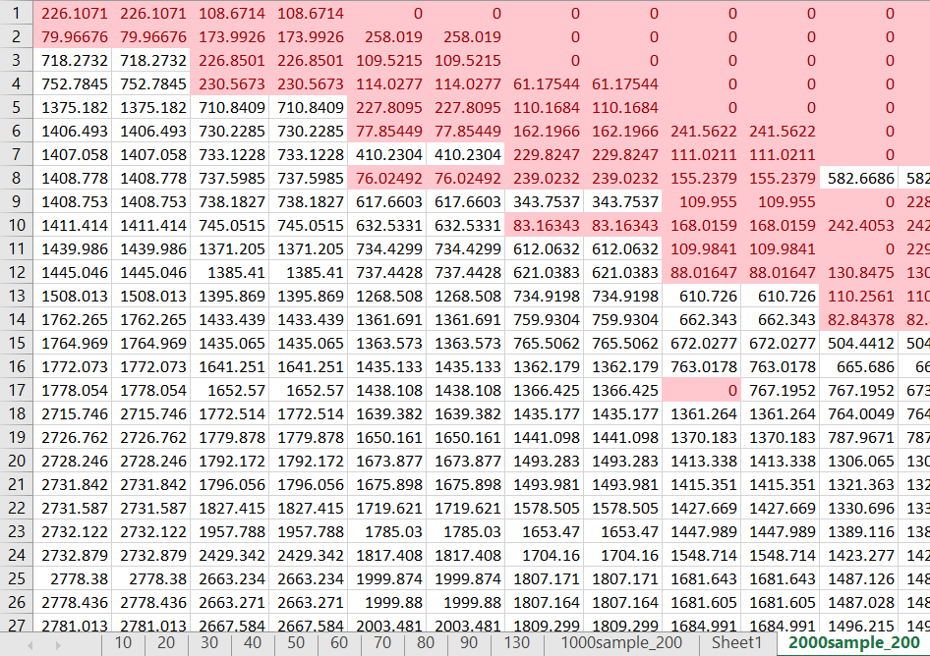
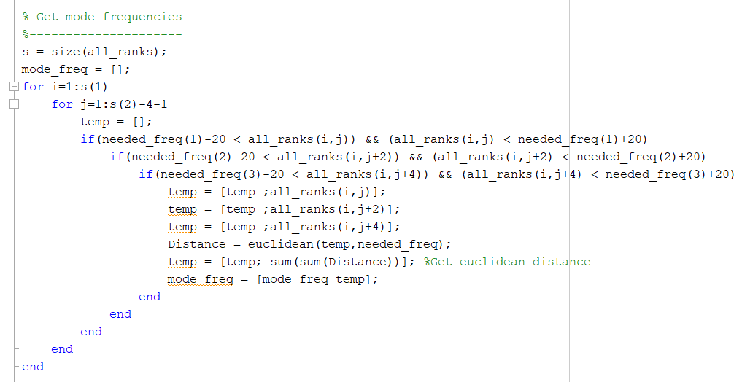
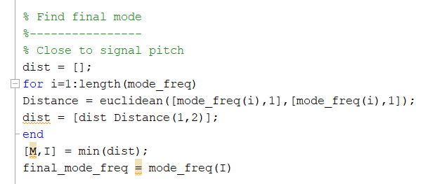
PROPOSED PIPELINE - CODE
No. of modes
Time-shift

Slide 26

PROPOSED PIPELINE
final_mode_freq =
39.0620

Slide 27
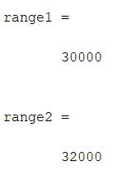
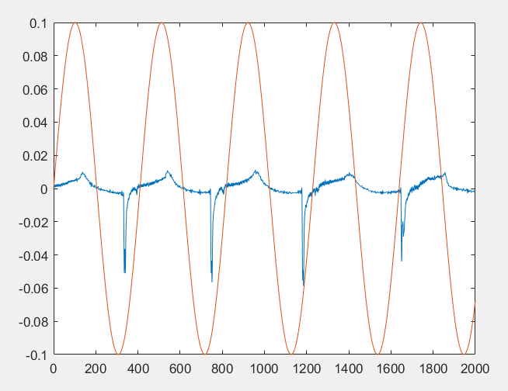
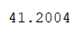
OUTPUT

Slide 28
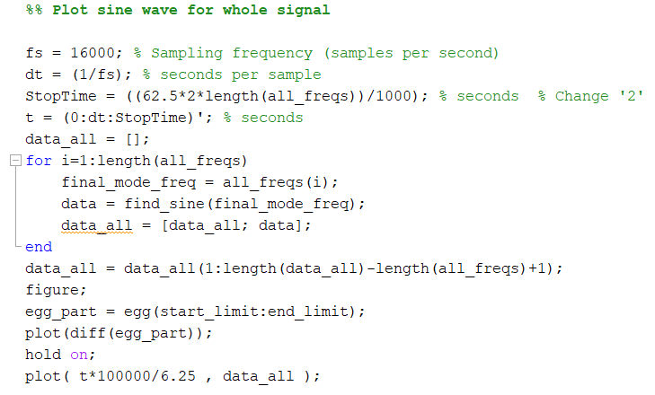
Apply for other speech frames

Slide 29
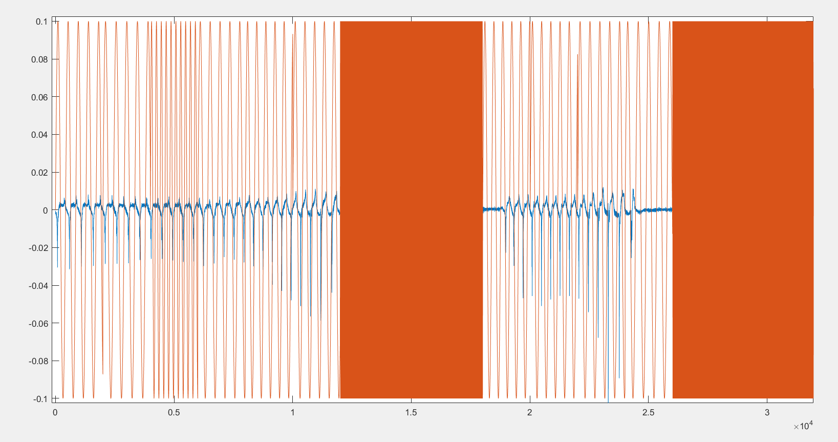
OUTPUT
Unvoiced
Voiced

Slide 30
05
FUTURE WORK
You can enter here the subtitle if you need it

Slide 31
FUTURE WORK
Reduce the Window size of each speech frame from 2000 to 1000 samples
Making a more generalized code for all speech signals
Finding metrics
Pitch Period
Jitter
Close Quotient
Speed Quotient
Applying the metrics for
Emotion recognition in speech signal
Speaker Identification

Slide 32

THANKS
Team 11

